Slide 1
7 Algorithm design and problem-solving
Computer sub-systems

Slide 2





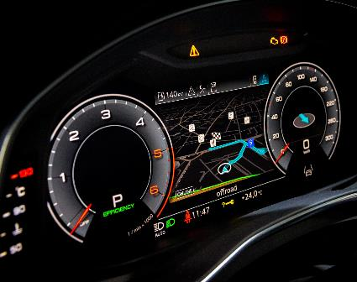
Computer sub-systems
Technology has permeated almost all aspects of our everyday life.
We probably interact with dozens of computer systems during the course of a normal day.
These systems can range from small and bespoke to large and complex.

Slide 3

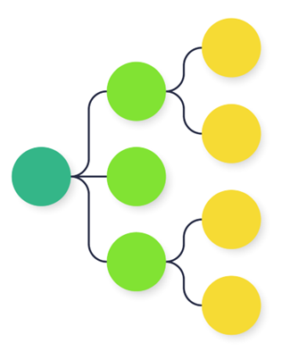
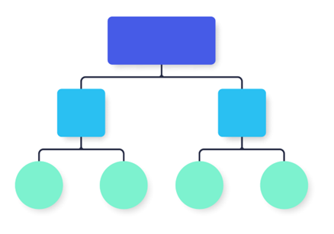
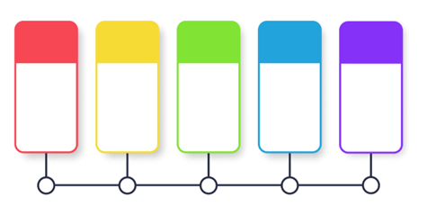
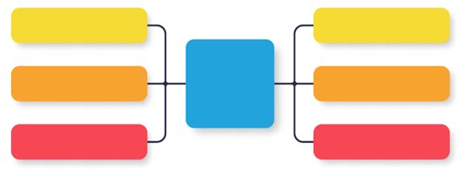
Computer sub-systems
Almost all computer systems can be broken down into a set of sub-systems.
Each sub-system can typically be divided into further sub-systems until each sub-system performs a single task or action.

Slide 4
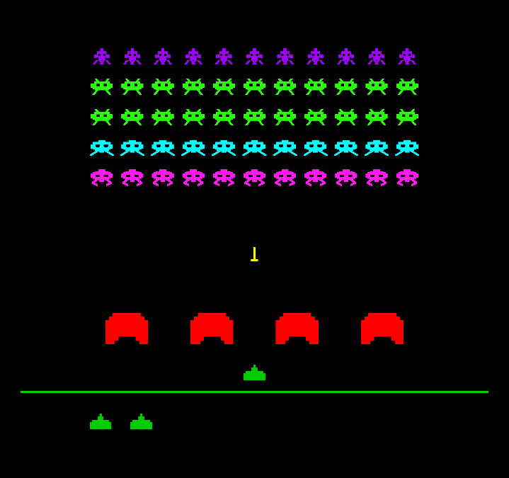
Computer sub-systems
Swarm
UFO
Take the example of classic shooter Space Invaders.
Analysis reveals many different sub-systems in the game.
Aliens collision
Player collision
Enemy missiles
Fire missile
Check win/lose
Game over
Title screen
Move player
Move player missile
Move UFO
Settings
Player ship
Alien missile collision
Move alien missile
Aliens fire
Missile collision
Move aliens
Spawn UFO
UFO collision

Slide 5
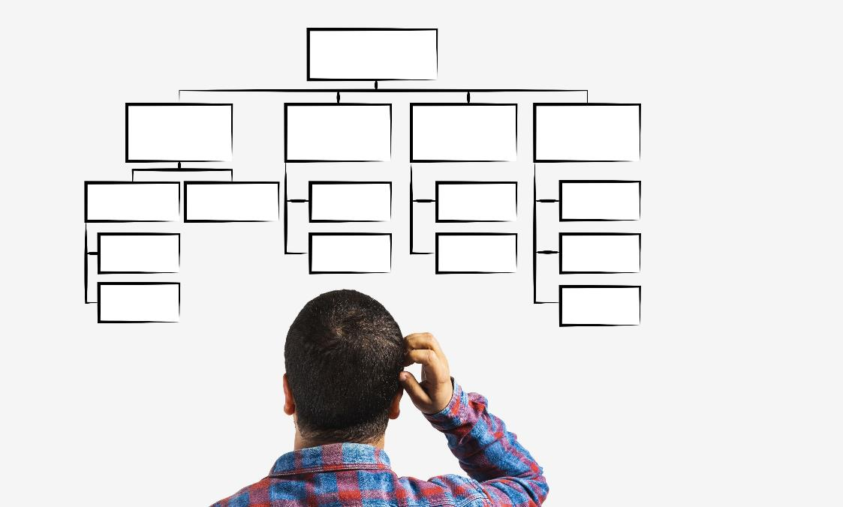
Computer sub-systems
One way to break the system down into its relevant sub-systems is a structured, top-down approach.

Slide 6
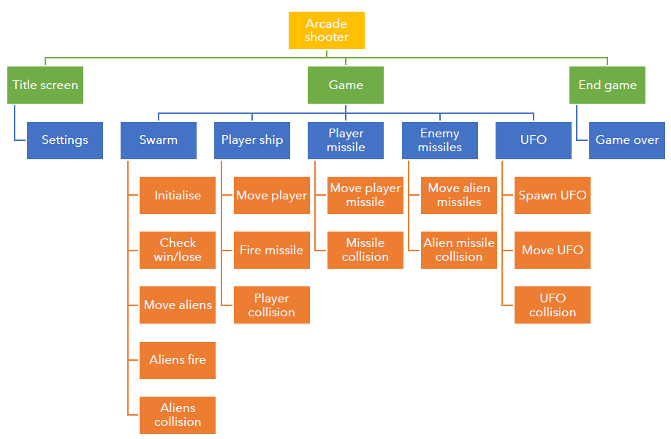

Computer sub-systems
Here is a structure diagram.
This is one just example of applying the analysis and design skill of decomposition to break a problem down into its various sub-problems.
Covered in more detail in the following videos:
7 Decomposition overview
7 Structure diagrams

Slide 7

Computer sub-systems
Computer systems range from small and simple to large and complex.
Almost all computer systems can be broken down into sub-systems. These sub-systems can typically be broken down into further sub-systems.
Eventually, each sub-system performs a single task or action.

Slide 8


